Slide 1
Social Media Hashtag Trend Analyzer
Name : Manan Gupta
Batch : ME 30

Slide 2

Introduction
The Social Media Hashtag Trend Analyzer is a web application that analyzes trends in hashtags from social media posts. The application is built using Python, SQL, AWS Lambda, DynamoDB, and Streamlit.
It allows users to input social media posts, extract hashtags, store them in a DynamoDB table, and see trending hashtags over time.

Slide 3

Purpose
Helps users identify trending hashtags in real-time, providing insights into social media trends and enhancing content.
Key Features
Real-Time Hashtag Analysis: Instantly track trending hashtags.
Data Storage: Store data securely in DynamoDB.
Visualizations: See trends with Streamlit.
Scalability: Efficiently manage large datasets with AWS Lambda.

Slide 4
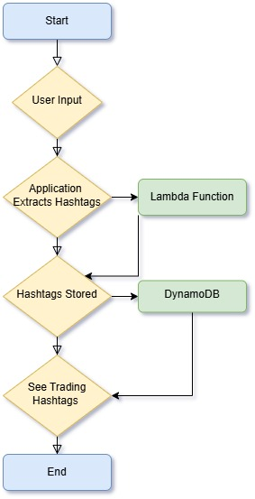
Workflow
Step-by-Step Process:
User inputs social media posts.
Application extracts hashtags.
Hashtags are stored in DynamoDB.
See trending hashtags over time.

Slide 5
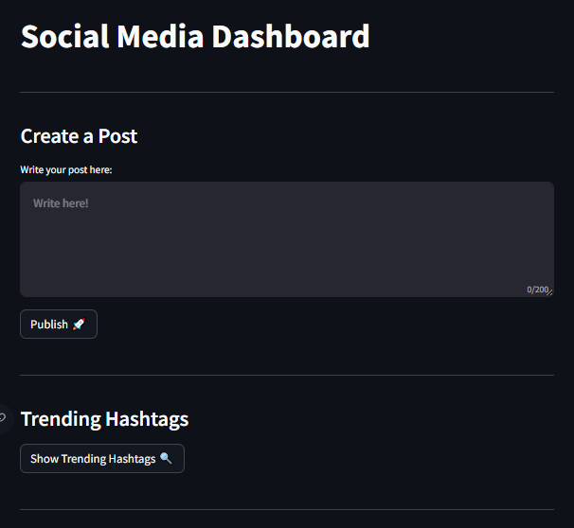
Layout

Slide 6
Thank You

